Slide 1
Front-End Frameworks: What is web framework?
front end frameworks are the software packages that provide pre-written/reusable code modules and standardized front end technologies and ready made interface blocks making the process of front end development a lot more faster and simple.
A software framework that is designed to support the development of web applications including web services, web resources, and web APIs.
HTML frameworks comprise standard codes that reduce the tedious job of coding for the developers.
JavaScript frameworks are an essential part of modern front-end web development, providing developers with tried and tested tools for building scalable, interactive web applications
A CSS framework comprises several CSS stylesheets ready for use by web developers and designers.

Slide 2
Why Web Framework
Web frameworks help us achieve structure in our applications, and they give us additional features we can add to them without too much extra work.
Frameworks give us a place to start so that we can focus on features rather than configuration details.
Frontend frameworks simplify the development process and make it easier to build a website or an application.
They provide various templates to interact with browser components, including prepared code that programmers can use to fix common programming tasks.

Slide 3
Web Framework Types.
There are two types or functions of web frameworks:
Server side (Backend)
client side (Frontend)
Backend frameworks
Backend frameworks or server side frameworks are used to create applications that users can interact with.
Their main purpose is to set up specialized functions on behalf of the software system.
In other words, the server side is the compilation of tools, scripts, API’s and external libraries, all the elements that are invisible to users.
The most used backend frameworks are Ruby , Django for Python, Express for JS.

Slide 4
Frontend Frameworks
Frontend, client side or CSS frameworks are the intermediary from the designer to the backend framework.
CSS frameworks are packages with pre-written standardized code in files and folders, they give you a base to build on allowing flexibility to the final design.
Numerous dynamic features can be build with front end frameworks as well as single page apps but one thing to keep in mind is that client side frameworks differ in functions and use

Slide 5
What is MVC
Model-View-Controller (MVC) is a software architectural pattern for implementing user interfaces.
It divides a given software application into three interconnected parts, so as to separate internal representations of information from the ways that information is presented to or accepted from the user.

Slide 6
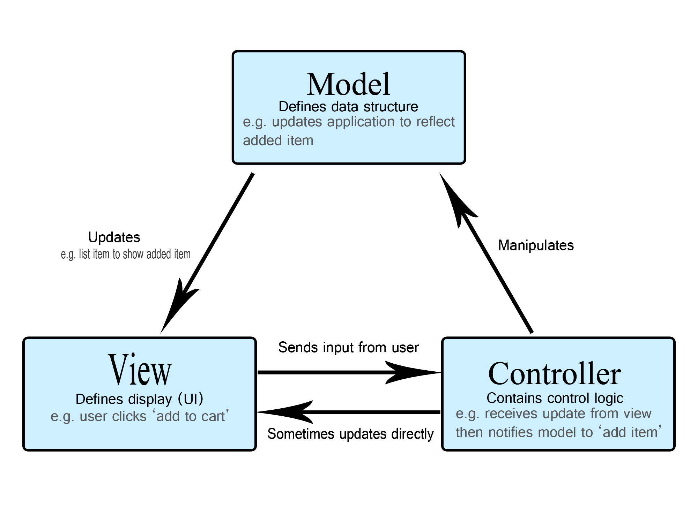
MVC Architecture

Slide 7
The Model-View-Controller (MVC) is an architectural pattern that separates an application into three main logical components: the model, the view, and the controller.
Each of these components are built to handle specific development aspects of an application.
MVC is one of the most frequently used industry-standard web development framework to create scalable and extensible projects

Slide 8
Model:
The Model component corresponds to all the data-related logic that the user works with. This can represent either the data that is being transferred between the View and Controller components or any other business logic-related data.
View:
The View component is used for all the UI logic of the application. For example, the Customer view will include all the UI components such as text boxes, dropdowns, etc. that the final user interacts with.
Controller:
Controllers act as an interface between Model and View components to process all the business logic and incoming requests, manipulate data using the Model component and interact with the Views to render the final output. For example, the Customer controller will handle all the interactions and inputs from the Customer View and update the database using the Customer Model. The same controller will be used to view the Customer data.

Slide 9
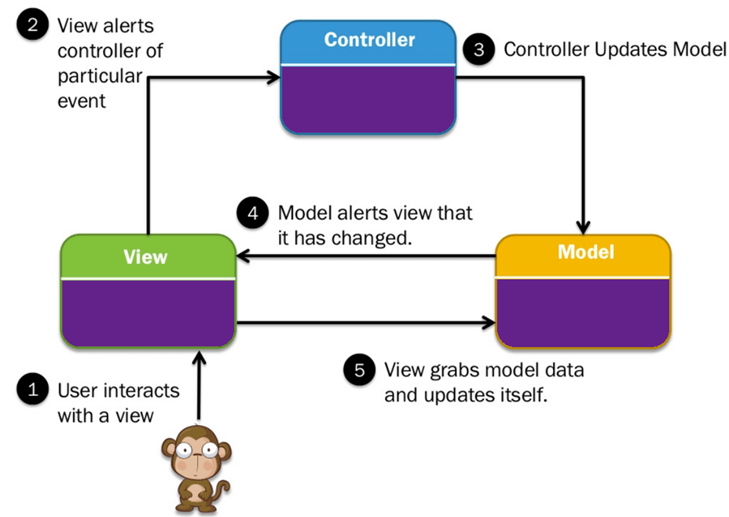
Car driving mechanism is example of the MVC model. Every car consist of three main parts. View= User interface : (Gear lever, panels, steering wheel, brake, etc.)

Slide 10
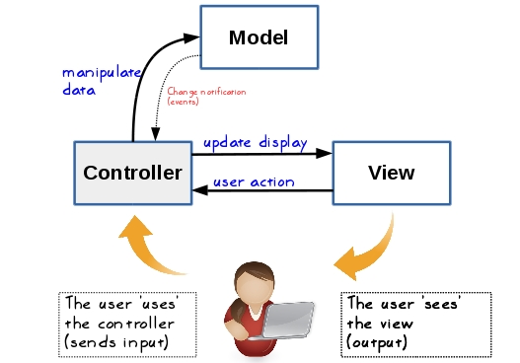
MVC in Practical

Slide 11
TypeScript: Introduction to TypeScript
It is developed and maintained by Microsoft under the Apache 2 license
TypeScript is an open-source
object-oriented programing language.
TypeScript is a strongly typed superset of JavaScript which compiles to plain JavaScript
TypeScript is not directly run on the browser. It needs a compiler to compile and generate in JavaScript file.
It contains all elements of the JavaScript.
It is a language designed for large-scale JavaScript application development, which can be executed on any browser, any Host, and any Operating System.

Slide 12
Variables and Constants, Modules in TS.
A variable is a named location in memory to store data. In TypeScript, an extension of Javascript, there are three different keywords to define variables: var , let , and const
Variable declaration: We can declare a variable in multiple ways like below:
var Identifier:Data-type = value;
var Identifier: Data-type;
var Identifier = value;
var Identifier;
Typescript constants are variables, whose values cannot be modified. We declare them using the keyword const.
They are block-scoped just like the let keyword.
Their value cannot be changed neither they can be redeclared.

Slide 13
Modules in TS.
TypeScript provides modules and namespaces in order to prevent the default global scope of the code and also to organize and maintain a large code base.
Modules are a way to create a local scope in the file.
all variables, classes, functions, etc. that are declared in a module are not accessible outside the module.

Slide 14
Angular CLI, Angular Architecture
Angular CLI's architecture consists of multiple small and focused libraries in charge of one specific feature.
The Angular CLI is a command-line interface tool that you use to initialize, develop maintain Angular applications directly from a command shell.
The @angular/cli is the main package.
It handles default behaviors and pre-defined commands.
Angular CLI's architecture consists of multiple small and focused libraries in charge of one specific feature.

Slide 15
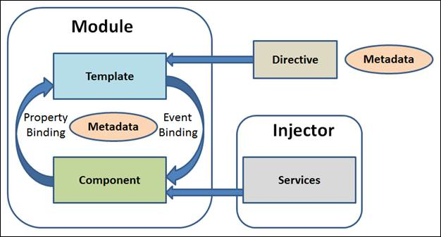

Slide 16
Angular is a framework for building client applications in HTML and either JavaScript or a language like TypeScript that compiles to JavaScript.
The framework consists of several libraries, some of them core and some optional
The core of the Angular framework architecture is Angular Component. Angular Component is the building block of every Angular application.
Every angular application is made up of one more Angular Component.
It is basically a plain JavaScript / Typescript class along with a HTML template and an associated name.

Slide 17
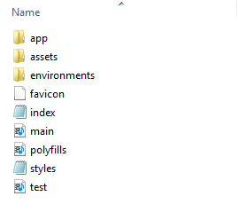
Angular Project Structure

Slide 18
node_modules folder
This folder is generated when we run "npm install" command. This folder contains third-party libraries and files. All these files are bundled in our project together.
dist folder
The "dist" folder is the build folder that has all the files and folders which can be hosted in the server. It has the compiled code of our angular project including .js, .html and .css files.
app folder
Contains "modules" and "components" for our Angular application.
It basically has,
app.component.css - Contains the CSS code for the component.
app.component.html - HTML file pointing to the app component. It is a template for the angular application.

Slide 19
Angular module
An Angular module is a deployment sub-set of your whole Angular application. Its useful for splitting up an application into smaller parts and lazy load each separately, and to create libraries of components that can be easily imported into other applications.
An AngularJS module defines an application.
The module is a container for the different parts of an application.
The module is a container for the application controllers.
Controllers always belong to a module.

Slide 20
Creating a Module
<div ng-app="myApp">...</div> <script> var app = angular.module("myApp", []); </script>
The "myApp" parameter refers to an HTML element in which the application will run.
Now you can add controllers, directives, filters, and more, to your AngularJS application
……….A module is created by using the AngularJS function angular.module

Slide 21
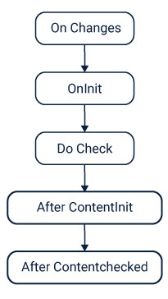
Angular Lifecycle
The lifecycle continues with change detection, as Angular checks to see when data-bound properties change, and updates both the view and the component instance as needed. The lifecycle ends when Angular destroys the component instance and removes its rendered template from the DOM.

Slide 22
ngOnInit()
A lifecycle hook that is called after Angular has initialized all data-bound properties of a directive. Define an ngOnInit() method to handle any additional initialization task
DoChecklink A lifecycle hook that invokes a custom change-detection function for a directive, in addition to the check performed by the default change-detector.
AfterContentInit
A lifecycle hook that is called after Angular has fully initialized all content of a directive. Define an ngAfterContentInit() method to handle any additional initialization tasks

Slide 23
Angular Components
Components are the main building block for Angular applications. Each component consists of:
An HTML template that declares what renders on the page
A TypeScript class that defines behavior
A CSS selector that defines how the component is used in a template
Optionally, CSS styles applied to the template

Slide 24
Creating a component using the Angular CLI
To create a component using the Angular CLI:
From a terminal window, navigate to the directory containing your application.
Run the ng generate component <component-name> command, where <component-name> is the name of your new component.
By default, this command creates the following:
A directory named after the component
A component file, <component-name>.component.ts
A template file, <component-name>.component.html
A CSS file, <component-name>.component.css
A testing specification file, <component-name>.component.spec.ts

Slide 25
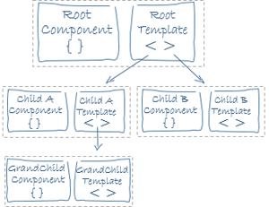
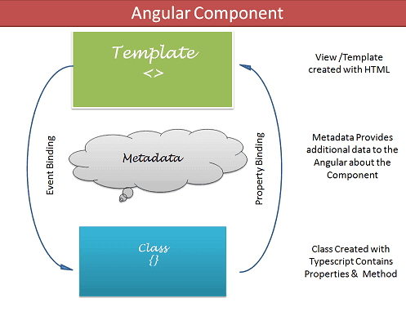
component

Slide 26
Angular Data Binding
Angular data binding is a two-way process: it can both send and receive data. This means that when you change something in your view, the model updates automatically, and vice versa. The ngModel directive makes this two-way data binding possible.
Data binding is a technique, where the data stays in between the component and the view. Whenever the user updates the data in the view, Angular updates the component. When the component gets new data, the Angular updates the view.
There are many uses of data binding. You can show models to the user, dynamically Change element style, respond to user events.

Slide 27
Data binding in AngularJS is the synchronization between the model and the view.
HTML View
The HTML container where the AngularJS application is displayed, is called the view.
The view has access to the model, and there are several ways of displaying model data in the view.
You can use the ng-bind directive, which will bind the inner HTML of the element to the specified model property:

Slide 28
One way binding
In one way binding data flows from one direction. Either from view to component or from component to view.
Two Way binding
Two-way binding means that changes made to our model in the component are propagated to the view and that any changes made in the view are immediately updated in the underlying component
Two-way binding is useful in data entry forms. Whenever a user makes changes to a form field, we would like to update our model.

Slide 29
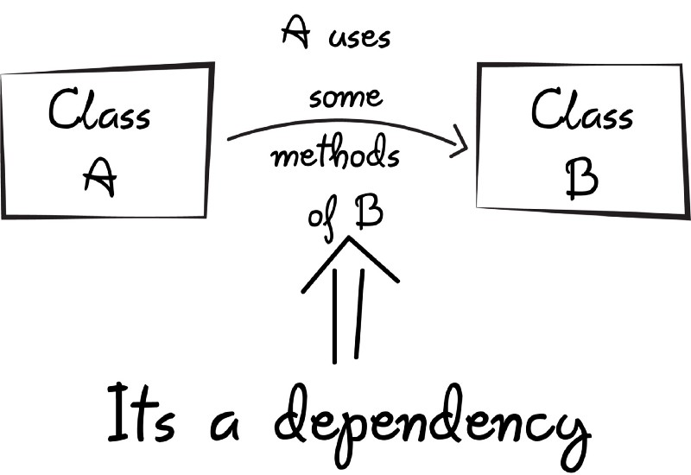
Dependency Injections (DI)
Dependency injection is used to make a class independent of its dependencies or to create a loosely coupled program. Dependency injection is useful for improving the reusability of code. Likewise, by decoupling the usage of an object, more dependencies can be replaced without needing to change class.

Slide 30
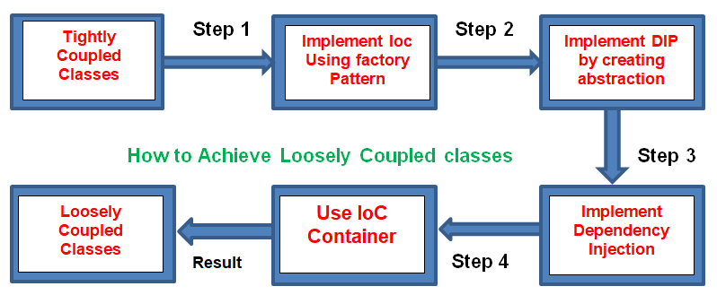

Slide 31
Angular Forms.
Angular provides two different approaches to handling user input through forms: reactive and template-driven. Both capture user input events from the view, validate the user input, create a form model and data model to update, and provide a way to track changes.
In Angular there are 2 approaches to handle user's input through forms:
Reactive forms
Template-driven forms
Both approaches are used to collect user input events from the view, validate the user input, create a form model and data model to update, and provide a way to track changes

Slide 32
Reactive Forms
Reactive forms are more robust.
Reactive forms are more scalable, reusable, and testable.
They are most preferred to use if forms are a key part of your application, or your application is already built using reactive patterns. In both cases, reactive forms are best to use.
Template-driven Forms
Template-driven forms are best if you want to add a simple form to your application. For example: email list signup form.
Template-driven forms are easy to use in the application but they are not as scalable as Reactive forms.
Template-driven forms are mainly used if your application's requires a very basic form and logic. It can easily be managed in a template.

Slide 33
Difference between Reactive Forms and Template-driven Forms
Comparison Index | Reactive Forms | Template-driven Forms
Setup (form model) | Reactive forms are more explicit. They are created in component class. | Template-driven forms are less explicit. They are created by directives.
Data model | Structured | Unstructured
Predictability | Synchronous | Asynchronous
Form validation | Functions | Directives
Mutability | Immutable | Mutable
Scalability | Low-level API access | Abstraction on top of APIs

